Slide 1

Your session title / Your name
Notes:
Slide 0: this slide will not automatically turned over. Show this BEFORE the acutal presentation starts.

Slide 2
README first
This is slide No 1.
The box below indicates the progress, it draws another line every 4 sec while pre-senting. Its just an animation. You can delete it, if it annoys you.
This slide will automatically call up the following slide after 20 seconds (and so on). A PechaKucha consists of 20 slides, each 20 seconds: 6 min 40 sec
Slide 0 contains also your title, your name and the sponsors logo.
If you want to tell a little bit about yourself, feel free to use one the 20 slides – but keep an eye on the time. Slide 0 does not automatically call up the next slide. It's just an indicator for the audience. The time counts down when you open slide 1.
1 / 20

Slide 3
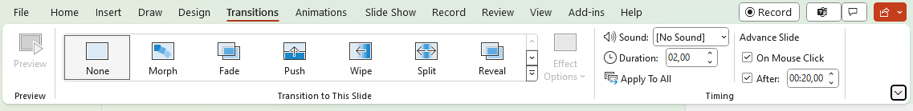
Automatic transition
You are requested to let the slides automatically move to the next item after 20 seconds. You can enable this in the Transitions menu, as seen
in the screenshot below:
2 / 20

Slide 4
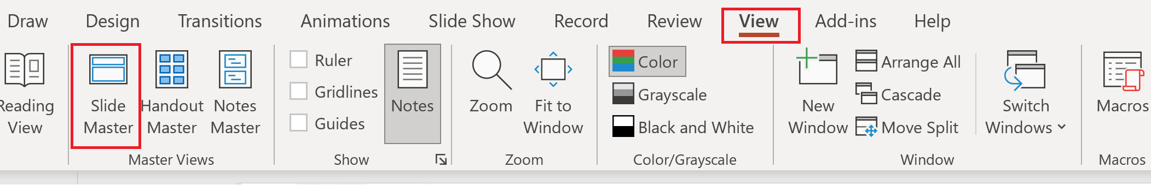
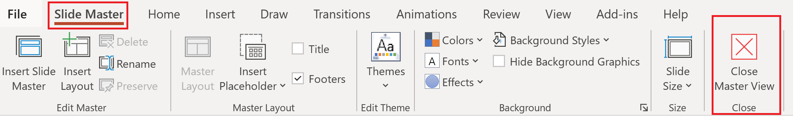
Update the social media handle
Open the slide master and replace the social media handle
3 / 20

Slide 5
A final tip
Keep your presentation entertaining,
sometimes just a picture might perfectly
support your explanations.
4 / 20

Slide 6
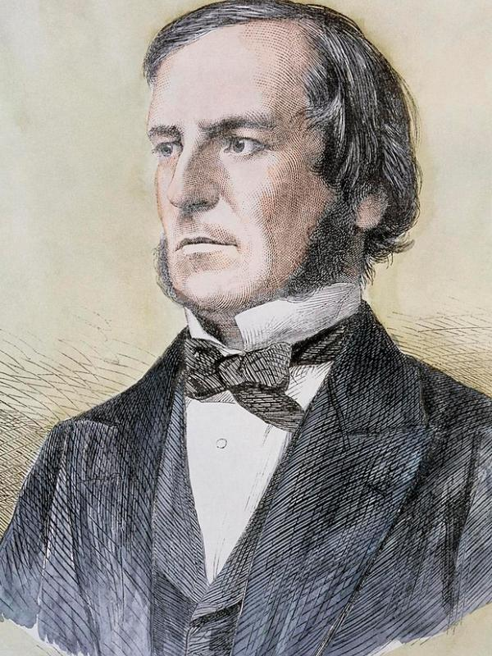
5 / 20

Slide 7
Yet another slide
foo bar
6 / 20

Slide 8
Yet another slide
foo bar
7 / 20

Slide 9
Yet another slide
foo bar
8 / 20

Slide 10
Yet another slide
foo bar
9 / 20

Slide 11
Yet another slide
foo bar
10 / 20

Slide 12
Yet another slide
foo bar
11 / 20

Slide 13
Yet another slide
foo bar
12 / 20

Slide 14
Yet another slide
foo bar
13 / 20

Slide 15
Yet another slide
foo bar
14 / 20

Slide 16
Yet another slide
foo bar
15 / 20

Slide 17
Yet another slide
foo bar
16 / 20

Slide 18
Yet another slide
foo bar
17 / 20

Slide 19
Yet another slide
foo bar
18 / 20

Slide 20
Yet another slide
foo bar
19 / 20

Slide 21
The final slide
Automatic turnover should be disabled on the last slide.
20 / 20

Slide 22
A final comment
Leo Visser added a nice animation to his PoShaKucha in 2025: a growing horizontal red line. You can watch his presentation here:
https://youtu.be/ThPuQAvoHGM (Side deck here)
If you find that more appealing, feel free to use his idea. You find the animated red line here above. But be careful, only use one animation – otherwise it can confuse PowerPoint.
21 / 20
Notes:
https://youtu.be/ThPuQAvoHGM
https://github.com/psconfeu/2025/blob/main/%23PoShaKucha/Leo%20Visser/CacheDataInModulePoShaKucha.pptx

